Slide 1
Master Technology Architect (MTA) Certification Program
Version 5.300 as of March 11, 2015

Slide 2
Agenda / Content
Objectives
Who Is This For?
Certification Levels & Progression
Key Responsibility and Role Expectations
High-Level Certification Process
How to Apply
Digital Architect (DA) Certification add-on
Appendix

Slide 3
Objectives
The MTA Certification Program was created to:
Identify our Technology Architects within the Accenture organization and their level of experience, to help ensure that projects and proposals have the right level of technology architecture expertise
Recognize our Technology Architects, acknowledging their capabilities
Have a well-defined career progression for Technology Architects, also providing visible role models for junior architects Additional details from the Notes section of this slide
See the MTA KX site for further details.
Notes:
The MTA Certification Program provides a consistent structure (criteria and expectations) across all workforces within the Accenture organization for career advancement as a Technology Architect as well as recognizing Technology Architects both internally and externally (market relevance).
- Support career progression (criteria, recognition, sponsorship) for those focusing on technology architecture (within and outside of AS&T and Architecture Innovation)
- Establishing technology architecture as a profession within Accenture
- Keep More (recognized career choice, with advancement to SE); Hire More (improve external image and recruiting effectiveness); Grow More (improve supply situation)
- Recognition and valuing of “Master Technology Architects” by Accenture and our clients
- External recognition by analysts and media
- Enable a network of across Accenture, responsible for the definition and delivery of architecture and advancing Accenture’s overall technology architecture capabilities
- Career guidance, opportunities and networking, enhancing career progression
- Institutionalize “Master Technology Architect” in Accenture’s business

Slide 4
Who Is This For?
The certification program is open to everyone at Accenture.
It is intended for those who want to pursue a career in technology architecture – developing breadth of skills and experience in multiple platforms and areas of technology.
Starting at the Analyst level (cross-workforce equivalent), for those who meet the criteria for entry into the certification program: 6 months Accenture tenure for Technology Architect Associate and Technology Architects; 12 months Accenture tenure for Senior and Master Technology Architect
Requires personal commitment to self-development and engagement with the community of Technology Architects
For those who want to develop breadth of technology skills and experience

Slide 5
Certification Levels & Progression
Progression: from TAA to TA to STA to MTA, which means TAA certification is recommended prior to TA, TA recommended prior to STA and STA is recommended prior to the MTA certification level – progression tracked via myCertification.
EXCEPTION: Cross-Workforce equivalent SMs and SEs that have worked as Technology Architects for at least 7 years may apply directly to the STA certification level (12 months Accenture tenure still required).
Registration Requirement (if not already certified): registration is required for all with the Technology Architecture capability and related curriculum: Technology Architect Associate (TAA) for cross-workforce equivalent Analysts and Junior Consultants, Technology Architect (TA) for Consultants and Managers; Senior Technology Architect (STA) for cross-workforce equivalent Senior Managers and Senior Executives.

Slide 6
Key Responsibility and Role Expectations
The following are key expectations Sponsors , Interviewers and Board Members will be looking to validate for applicants by certification level; possible responsibilities, roles, etc.
See the MTA KX site’s Messages from the Board to those Certified page for further details.

Slide 7

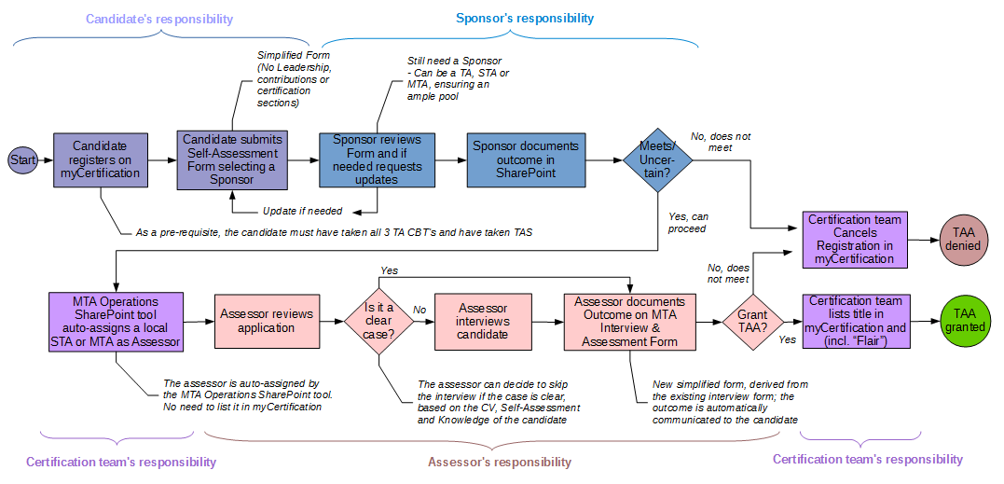
High-Level Certification Process (TAA)
Access the Process Step Details page from the MTA KX site for details.
Notes:
NOTE: this process flow is high-level to provide a general overview - it does not represent specifics and details pertaining to different certification levels or comprehensive activities performed within and outside of the learning management system (myCertification). Sponsors Required: 1 for TA/STA, 2 for MTA. Tenure Requirements: 6 months for TA; 12 months for STA / MTA. Progression: from TA to STA to MTA, which means TA certification is recommended prior to STA and STA is recommended prior to the MTA certification level – tracked via myCertification. Registration Requirement (if not already certified): registration is required for all with the Technology Architecture capability and related curriculum: Technology Architect (TA) for cross-workforce equivalent Consultants and Managers; Senior Technology Architect (STA) for cross-workforce equivalent Senior Managers and Senior Executives. Online ReL courses required: “MTA - 2010 - What is Technology Architecture?”; “MTA - 2020 - The Role of a Technology Architect”; “MTA - 2030 - Technology Architecture Concerns and Principles”. Technology Architecture School (TAS) required for TA certification (with the exception of SMs and SEs): Central Course Code Z80016 (Tuition $1,250) - OR - Local Course Code Z84949 (zero tuition). Advanced Technology Architecture School (ATAS) required for MTA certification: Central Course Code Z58637 (Tuition $1,550) - OR - Local Course Code Z84953 (zero tuition).

Slide 8
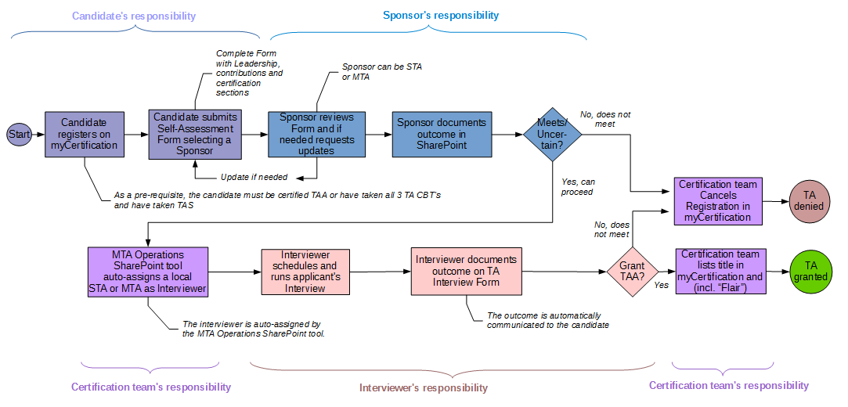
High-Level Certification Process (TA)
Access the Process Step Details page from the MTA KX site for details.
Notes:
NOTE: this process flow is high-level to provide a general overview - it does not represent specifics and details pertaining to different certification levels or comprehensive activities performed within and outside of the learning management system (myCertification). Sponsors Required: 1 for TA/STA, 2 for MTA. Tenure Requirements: 6 months for TA; 12 months for STA / MTA. Progression: from TA to STA to MTA, which means TA certification is recommended prior to STA and STA is recommended prior to the MTA certification level – tracked via myCertification. Registration Requirement (if not already certified): registration is required for all with the Technology Architecture capability and related curriculum: Technology Architect (TA) for cross-workforce equivalent Consultants and Managers; Senior Technology Architect (STA) for cross-workforce equivalent Senior Managers and Senior Executives. Online ReL courses required: “MTA - 2010 - What is Technology Architecture?”; “MTA - 2020 - The Role of a Technology Architect”; “MTA - 2030 - Technology Architecture Concerns and Principles”. Technology Architecture School (TAS) required for TA certification (with the exception of SMs and SEs): Central Course Code Z80016 (Tuition $1,250) - OR - Local Course Code Z84949 (zero tuition). Advanced Technology Architecture School (ATAS) required for MTA certification: Central Course Code Z58637 (Tuition $1,550) - OR - Local Course Code Z84953 (zero tuition).

Slide 9
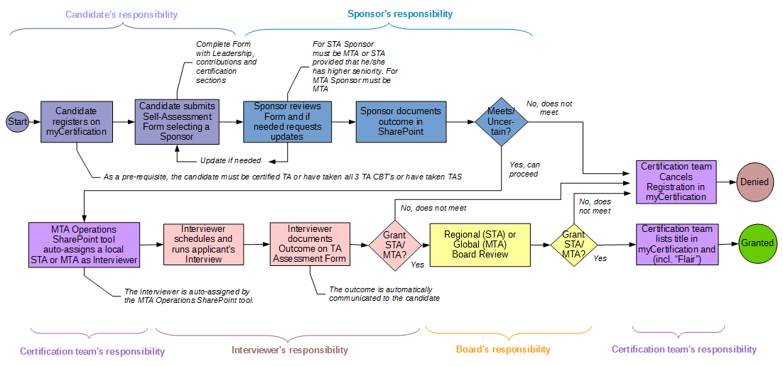
High-Level Certification Process (STA/MTA)
Access the Process Step Details page from the MTA KX site for details.
Notes:
NOTE: this process flow is high-level to provide a general overview - it does not represent specifics and details pertaining to different certification levels or comprehensive activities performed within and outside of the learning management system (myCertification). Sponsors Required: 1 for TA/STA, 2 for MTA. Tenure Requirements: 6 months for TA; 12 months for STA / MTA. Progression: from TA to STA to MTA, which means TA certification is recommended prior to STA and STA is recommended prior to the MTA certification level – tracked via myCertification. Registration Requirement (if not already certified): registration is required for all with the Technology Architecture capability and related curriculum: Technology Architect (TA) for cross-workforce equivalent Consultants and Managers; Senior Technology Architect (STA) for cross-workforce equivalent Senior Managers and Senior Executives. Online ReL courses required: “MTA - 2010 - What is Technology Architecture?”; “MTA - 2020 - The Role of a Technology Architect”; “MTA - 2030 - Technology Architecture Concerns and Principles”. Technology Architecture School (TAS) required for TA certification (with the exception of SMs and SEs): Central Course Code Z80016 (Tuition $1,250) - OR - Local Course Code Z84949 (zero tuition). Advanced Technology Architecture School (ATAS) required for MTA certification: Central Course Code Z58637 (Tuition $1,550) - OR - Local Course Code Z84953 (zero tuition).

Slide 10
How to Apply 1/2
Before applying, ensure that you have completed all three (3) of the prerequisite web-based training (WBTs) available:
MTA - 2010 V2 - What is Technology Architecture?
MTA - 2020 V2 - The Role of a Technology Architect
MTA - 2030 V2 - Technology Architecture Concerns and Principles
Apply via myCertification by registering for enrollment in the respective activity
Technology Architect Associate Certification (MTA7000)
Prerequisites: 3 aforementioned WBTs
Technology Architect Certification (MTA4000)
Prerequisites: 3 aforementioned WBTs
Technology Architecture School required (Central Z80016 $1,250 – OR – Local Z84949 $0)
SMs/SEs do not need to complete TAS when applying for TA
Completion of ATAS automatically fulfills the training requirement for the TA certification level
Senior Technology Architect Certification (MTA5000)
It is typically expected that applicants apply for TA first, before applying for STA (SMs/SEs that have worked as Technology Architects for at least 7 years may apply directly to the STA certification level)
Master Technology Architect Certification (MTA6000)
it is typically expected that applicants apply for STA first, before applying for MTA

Slide 11

How to Apply 2/2
Update CV/Résumé in myScheduling
Create and Submit “Self-Assessment”
See the MTA KX site’s Apply to the Program page for details.
NOTE: Avanade employees cannot be processed via myCertification. Such applicants should contact TA.Certification@accenture.com with their interest in pursuing certification, attaching their CV/Résumé file.

Slide 12
Digital Architect Certification Add-on 1/2
We have a “digital architecture” skill gap, at 2 levels:
not enough senior architects (SM-MD, STA-MTA) able to shape & discuss with clients end-to-end solutions with any/all “digital” components;
not enough junior/intermediated architects (C-M, TA) able to lead an architecture team implementing such solutions.
To fill these gaps the Digital Architect Certification add-on has been launched in 2015
To be eligible for a “Digital Architect” certification, candidates must:
be already certified by the MTA Programme at the TA, STA or MTA level (not TAA);
be able to clearly articulate what “Digital” is, and what all the typical components of a Digital technology landscape are (i.e. must be at least “familiar” with 80%+ of the Digital Skill Areas);
be “capable” or “expert” in at least 30% of the Digital Skill Areas;
have worked as Technology Architect on Digital-relevant proposals & projects (and on a Digital-relevant part of the Architecture) for at least 12 months (or 6 months + 40 hours of Digital-specific training);

Slide 13
Digital Architect Certification add-on 2/2
Below the process to be followed to obtain the DA Certification; for more information please refer to: https://kxsites.accenture.com/groups/MTA/Pages/TopicPages/DigitalArchitectCertification.aspx?lftTitle=Digital+Architect+Certification

Slide 14
Appendix

Slide 15
Key Links to Sites & Content
The following links are key to the MTA Certification Program.
Master Technology Architect KX Site
Learn About the Program; Apply to the Program; After Certification; Spotlight
Program Administration Team eMail: MTA.Certification@accenture.com
Required Rapid eLearning Courses:
MTA - 2010 V2 - What is Technology Architecture?
MTA - 2020 V2 - The Role of a Technology Architect
MTA - 2030 V2 - Technology Architecture Concerns and Principles
Required Classroom Training (TAS for TA):
Technology Architecture School (Central Z80016 $1,250 – OR – Local Z84949 $0)
Accenture Master Technology Architect Certification Program (The Hub)
Driving Innovation through the MTA Certification Program Workshop & Awards Wrap Up
Accenture Master Technology Architect Certification (U.S. External Marketing Page)
AS&T Innovation KX Site
Advanced Systems and Technology KX Site

Slide 16
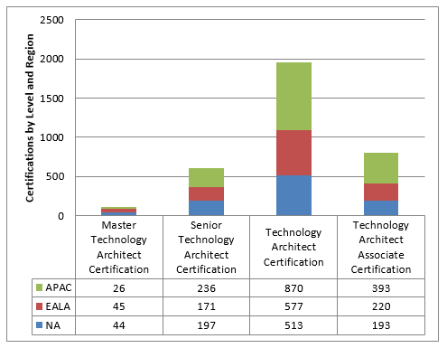
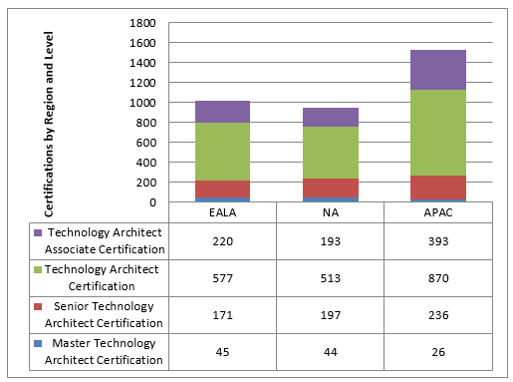
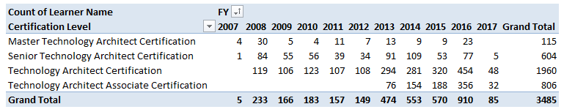
Current MTA Certification Count
3, 485 Certified as TA, STA or MTA (as of September 30, 2016)
MTA: 115, STA: 604, TA: 1960, TAA: 806
Thanks to all of you who have taken the time to apply, and to all those helping with deployment through assessments and interviews. Your time and effort is well recognized and appreciated. The list of certified personnel can be downloaded here. See the MTA KX site’s Current Certification Count page for further details.

Slide 17
Several Teams Engaged
There are several different teams engaged in the design, development, and ongoing support of internal certification programs.
Business Sponsors establish vision for the program and partners with the Capability Solutions to ensure the program is designed and positioned to meet its objectives.
Capability Solutions serves as the driver of the certification development process and as the long-term owner of the program post deployment. Key activities include:
Definition of the business case
Development of course/assessments
Definition and execution of the marketing / communication plan
Serving as primary POC for business sponsor; securing necessary approvals
Certifications Team supports the process through the use of well defined models, tools, and templates; ensuring the program reflects all our certification strategy and best practices and can operate within the defined standards.
Accenture Learning supports the process through the development of certification assessments, build of the programs in myCertification, and the management of delivery responsibilities post deployment.

